Slide 1
CISC 181-INTRODUCTION TO COMPUTER SCIENCE II
Week 13
Spring 2024

Slide 2
Class Methods

Slide 3
Adding functionality to a class
Encapsulation is a key concept of this course. The idea of creating reusable, self contained types which contain both data, and functions ot operate on that data is central to Object-Oriented Programming
Let's consider our drawing example from the previous chapter
class Color{ constructor(public red:number, public green:number,public blue:number){ } } class Point{ constructor(public x:number,public y:number,public color:Color){} } class Line{ constructor(public start:Point,public end:Point,public color:Color){} } class Rectangle{ constructor(public corner1:Point,public corner2:Point,public color:Color){} }

Slide 4
Adding functionality to a class
Encapsulation is a key concept of this course. The idea of creating reusable, self contained types which contain both data, and functions ot operate on that data is central to Object-Oriented Programming
Specifically, if we look at our Line class which contains two points with x and y coordinates, we might want an easy way to get a line's length. We can expand our definition of a line to contain a method to accomplish this. The getLength() method can be added inside the class definition.
class Line{ constructor(public start:Point,public end:Point,public color:Color){} getLength():number{ let x=this.start.x-this.end.x; let y=this.start.y-this.end.y; let len:number=Math.sqrt(x*x+y*y); return len; } }

Slide 5
Adding functionality to a class
Encapsulation is a key concept of this course. The idea of creating reusable, self contained types which contain both data, and functions ot operate on that data is central to Object-Oriented Programming
Note that we don’t need to know how the line is represented to use this method. If we have a line and want it’s length, we simply call the getLength method. This is important because in the future we might change the internal representation of a line, but this method would still work if we rewrote it. The calling program would not need to change.
Let's try it:
import {Color,Point} from 'ch4/drawing1'; class Line{ constructor(public start:Point,public end:Point,public color:Color){} public getLength():number{ let x=this.start.x-this.end.x; let y=this.start.y-this.end.y; let len:number=Math.sqrt(x*x+y*y); return len; } } let myLine:Line=new Line(new Point(0,0,new Color(0,0,0)),new Point(100,100,new Color(0,0,0)),new Color(255,0,0)); let lineLen:number=myLine.getLength(); console.log(lineLen);

Slide 6
Adding functionality to a class
Encapsulation is a key concept of this course. The idea of creating reusable, self contained types which contain both data, and functions ot operate on that data is central to Object-Oriented Programming
We can add as many methods as we want to a class. The methods allow us to manipulate the data within the class or do calculations using the data within the class without knowing how the data within the class is actually represented. The method itself must obviously know, but external code that uses the class does not need to know anything about the internal structure. Later we will use the private keyword to hide that information from users of the class. Our class will have a public interface which may be separate from its private internal representation.

Slide 7
Default Parameters
Encapsulation is a key concept of this course. The idea of creating reusable, self contained types which contain both data, and functions ot operate on that data is central to Object-Oriented Programming
It is possible to provide default values for the parameters in the function signature. We can use this to provide default values for our color class. Now we can create a color object with these default values. In the example below, we create a color with a specific color, and one using the defaults (0,0,0).
class Color{ constructor(public red:number=0, public green:number=0,public blue:number=0){ } } let specificColor:Color=new Color(255,128,44); let defaultColor:Color=new Color(); console.log(specificColor); console.log(defaultColor);

Slide 8
Another example
Encapsulation is a key concept of this course. The idea of creating reusable, self contained types which contain both data, and functions ot operate on that data is central to Object-Oriented Programming
Let's try to add a getArea() method to our rectangle class. This should be straight forward since we have the corners.
class Rectangle{ constructor(public corner1:Point,corner2:Point,color:Color){} getArea():number{ //we want to multiply width * height, but we already have a way to get the width and the height //using our line class from before. //Our width is (this.corner1.x,this.corner1,y) to (this.corner2.x,this.corner1.y) //Our height is (this.corner1.x,this.corner1.y) to (this corner1.x,this.corner2.y) //make lines for the top and left of the rectangle, and get there lengths, and multiply them together. } }

Slide 9
Another example
Encapsulation is a key concept of this course. The idea of creating reusable, self contained types which contain both data, and functions ot operate on that data is central to Object-Oriented Programming
The area is the length of the line from (corner1.x,corner1.y) to (corner2.x,corner1.y) times the length of th eline from (corner1.x,corner1.y) to (corner1.x,corner2.y)

Slide 10
Another example
Encapsulation is a key concept of this course. The idea of creating reusable, self contained types which contain both data, and functions ot operate on that data is central to Object-Oriented Programming
import {Color,Point} from 'ch4/drawing1'; class Line{ constructor(public start:Point,public end:Point,public color:Color){} getLength():number{ let x=this.start.x-this.end.x; let y=this.start.y-this.end.y; let len:number=Math.sqrt(x*x+y*y); return len; } } class Rectangle{ constructor(public corner1:Point,public corner2:Point,public color:Color){} getArea():number{ let corner3:Point=new Point(this.corner2.x,this.corner1.y,new Color()); let corner4:Point=new Point(this.corner1.x,this.corner2.y,new Color()); let horizLine:Line=new Line(this.corner1,corner3,new Color()); let vertLine:Line=new Line(this.corner1,corner4,new Color()); let area:number=horizLine.getLength()*vertLine.getLength(); return area; } } let rect:Rectangle=new Rectangle(new Point(0,0,new Color()),new Point(100,100,new Color()),new Color()); console.log(rect.getArea());

Slide 11
Exercises
Encapsulation is a key concept of this course. The idea of creating reusable, self contained types which contain both data, and functions ot operate on that data is central to Object-Oriented Programming
Fill in the method getDiagonals(), getPerimeter(), and getDiagonalLength() methods as specified in the comments.
import {Color,Point} from 'ch4/drawing1'; class Line{ constructor(public start:Point,public end:Point,public color:Color){} getLength():number{ let x=this.start.x-this.end.x; let y=this.start.y-this.end.y; let len:number=Math.sqrt(x*x+y*y); return len; } } class Rectangle{ constructor(public corner1:Point,public corner2:Point,public color:Color){} getArea():number{ let corner3:Point=new Point(this.corner2.x,this.corner1.y,new Color()); let corner4:Point=new Point(this.corner1.x,this.corner2.y,new Color()); let horizLine:Line=new Line(this.corner1,corner3,new Color()); let vertLine:Line=new Line(this.corner1,corner4,new Color()); let area:number=horizLine.getLength()*vertLine.getLength(); return area; } /** * Return an array of line objects which represent the two diagonals of the rectangle. * @param none * @returns An array of 2 points representing the diagonals. The first point in the array should be top * left to bottom right. The second point should be top right to bottom left. * @sideEffects None */ getDiagonals():Line[]{ } /** * Return the length of the diagonal of the rectangle. * @param none * @returns The length of the diagonal of the rectangle. * @sideEffects None */ getPerimeter(): number { } /** * Return the length of the diagonal of the rectangle. * @param none * @returns The length of the diagonal of the rectangle. * @sideEffects None */ getDiagonalLength():number{ } } let rect:Rectangle=new Rectangle(new Point(0,0,new Color()),new Point(100,100,new Color()),new Color()); console.log(rect.getDiagonals()); console.log(rect.getPerimeter()); console.log(rect.getDiagonalLength())

Slide 12
Exercises
Encapsulation is a key concept of this course. The idea of creating reusable, self contained types which contain both data, and functions ot operate on that data is central to Object-Oriented Programming
class Line{ constructor(public start:Point,public end:Point,public color:Color){} getLength():number{ let x=this.start.x-this.end.x; let y=this.start.y-this.end.y; let len:number=Math.sqrt(xx+yy); return len; } } class Rectangle{ constructor(public corner1:Point,public corner2:Point,public color:Color){}

Slide 13
Exercises
Encapsulation is a key concept of this course. The idea of creating reusable, self contained types which contain both data, and functions ot operate on that data is central to Object-Oriented Programming
getArea():number{ let corner3:Point=new Point(this.corner2.x,this.corner1.y,new Color()); let corner4:Point=new Point(this.corner1.x,this.corner2.y,new Color()); let horizLine:Line=new Line(this.corner1,corner3,new Color()); let vertLine:Line=new Line(this.corner1,corner4,new Color()); let area:number=horizLine.getLength()*vertLine.getLength(); return area; } /** * Return an array of line objects which represent the two diagonals of the rectangle. * @param none * @returns An array of 2 points representing the diagonals. The first point in the array should be top * left to bottom right. The second point should be top right to bottom left. * @sideEffects None */ getDiagonals():Line[]{ let corner3:Point=new Point(this.corner2.x,this.corner1.y,new Color()); let corner4:Point=new Point(this.corner1.x,this.corner2.y,new Color()); let result=[ new Line(this.corner1,this.corner2,new Color()), new Line(corner4,corner3,new Color()), ]; return result; } /** * Return the length of the diagonal of the rectangle. * @param none * @returns The length of the diagonal of the rectangle. * @sideEffects None */ getPerimeter(): number { let corner3:Point=new Point(this.corner2.x,this.corner1.y,new Color()); let corner4:Point=new Point(this.corner1.x,this.corner2.y,new Color()); let horizLine:Line=new Line(this.corner1,corner3,new Color()); let vertLine:Line=new Line(this.corner1,corner4,new Color()); return horizLine.getLength()*2+vertLine.getLength()*2; } /** * Return the length of the diagonal of the rectangle. * @param none * @returns The length of the diagonal of the rectangle. * @sideEffects None */ getDiagonalLength():number{ let diags:Line[]=this.getDiagonals(); return diags[0].getLength(); }
} let rect:Rectangle=new Rectangle(new Point(0,0,new Color()),new Point(100,100,new Color()),new Color()); console.log(rect.getDiagonals()); console.log(rect.getPerimeter()); console.log(rect.getDiagonalLength())

Slide 14
Exercises
Encapsulation is a key concept of this course. The idea of creating reusable, self contained types which contain both data, and functions ot operate on that data is central to Object-Oriented Programming
</details> One thing to notice is that we had to compute the missing corners in every function. It would make more sense to compute them when the object is created and store them as member variables. We can do this without changing the ***public interface*** of the class and simplify all of our member methods. We will do this in the next section. So now we can add methods to our classes to create robust objects that encapsulate not just some heterogeneous data, but also methods that can work on that data. We can use the classes to create instances with the new operator which store their own data, and have methods that work on the data inside the instance. ```typescript let color1=new Color(0,0,0); let color2=new Color(255,255,255); color1.red=255;
NOTE: color2 is unchanged. It is a distinct instance of our class Color.

Slide 15
Summary
Encapsulation is a key concept of this course. The idea of creating reusable, self contained types which contain both data, and functions ot operate on that data is central to Object-Oriented Programming
Classes in typescript can contain only data (Data Classes) or they can contain a combination of data and methods that operate on that data. The methods can access the properties of the class instance by using the this keyword. In this way, we can create classes that not only combine data that goes together, but also encapsulate it with the methods that act upon that data.

Slide 16
Data Hiding

Slide 17
Data Hiding
Classes allow us to combine data and methods into a grouping or class and use that grouping as a data type in our programs.
Consider our rectangle class again:
class Rectangle{ constructor(public corner1:Point, public corner2:Point,public color:Color){ } }

Slide 18
Data Hiding
Classes allow us to combine data and methods into a grouping or class and use that grouping as a data type in our programs.
We made all of the member variables (properties) public for simplicity, but now we cannot change the internal representation. Making members private hides them from everything outside the class making them inaccessible. We can rewrite this class making our point members private.
class Rectangle{ constructor(private corner1:Point, private corner2:Point,public color:Color){} }

Slide 19
Data Hiding
Classes allow us to combine data and methods into a grouping or class and use that grouping as a data type in our programs.
Nothing changes except we cannot access corner1 and corner2 outside our class, but our methods (diagonal, area, perimeter) that we wrote in the exercise in the previous chapter are fine because they are inside the class. We can still create a rectangle and call our methods on it, we just can’t get the corners any more. If we really need them, we can write methods to get them or change them.
But Why? Imagine we wrote this for a client, and suddenly after we have written a 100,000 line drawing program they want us to add the ability to rotate a rectangle. Our implementation DOES NOT ALLOW THIS!!!. Also, many of the methods we wrote required us to compute the missing corners. If we stored all 4 corners, then we could do all of these things without breaking the 100,000 lines of external code.
We can make the change easily without breaking anything outside our code. We will renumber the corners from the upper left clockwise for simplicity. Note that we do not change the signature of the constructor, only the hidden data.
class Rectangle{ private corner2:Point; private corner4:Point; constructor(private corner1:Point, private corner3:Point,public color:Color){ this.corner2=new Point(corner3.x,corner1.y,color); this.corner4=new Point(corner1.x,corner3.y,color); } }

Slide 20
Data Hiding
Classes allow us to combine data and methods into a grouping or class and use that grouping as a data type in our programs.
Nothing is changed in how you create instances of this class, but now we have all 4 points stored. Now we could add a rotate method if we choose.
Because we relabled our corners, and added the new corners, we should rewrite all of the internal methods (but we won't change the signature of the method).
Here is a complete working example:
import {Color,Point} from 'ch5/drawing1'; class Line{ constructor(public start:Point,public end:Point,public color:Color){} getLength():number{ let x=this.start.x-this.end.x; let y=this.start.y-this.end.y; let len:number=Math.sqrt(x*x+y*y); return len; } } class Rectangle{ private corner2:Point; private corner4:Point; constructor(private corner1:Point, private corner3:Point,public color:Color){ this.corner2=new Point(corner3.x,corner1.y,color); this.corner4=new Point(corner1.x,corner3.y,color); } getArea():number{ let horizLine:Line=new Line(this.corner1,this.corner2,new Color()); let vertLine:Line=new Line(this.corner1,this.corner4,new Color()); let area:number=horizLine.getLength()*vertLine.getLength(); return area; } /** * Return an array of line objects which represent the two diagonals of the rectangle. * @param none * @returns An array of 2 points representing the diagonals. The first point in the array should be top * left to bottom right. The second point should be top right to bottom left. * @sideEffects None */ getDiagonals():Line[]{ let result=[ new Line(this.corner1,this.corner3,new Color()), new Line(this.corner4,this.corner2,new Color()), ]; return result; } /** * Return the length of the diagonal of the rectangle. * @param none * @returns The length of the diagonal of the rectangle. * @sideEffects None */ getPerimeter(): number { let horizLine:Line=new Line(this.corner1,this.corner2,new Color()); let vertLine:Line=new Line(this.corner3,this.corner4,new Color()); return horizLine.getLength()*2+vertLine.getLength()*2; } /** * Return the length of the diagonal of the rectangle. * @param none * @returns The length of the diagonal of the rectangle. * @sideEffects None */ getDiagonalLength():number{ let diags:Line[]=this.getDiagonals(); return diags[0].getLength(); } } let rect:Rectangle=new Rectangle(new Point(0,0,new Color()),new Point(100,100,new Color()),new Color()); console.log(rect.getDiagonals()); console.log(rect.getPerimeter()); console.log(rect.getDiagonalLength())

Slide 21
Summary
Classes allow us to combine data and methods into a grouping or class and use that grouping as a data type in our programs.
Data hiding is an important tool for object oriented programming. It allows us, as the programmer, to decide what functionality, methods, and data we expose to the users of our class without worrying about things we have hidden inside. If we provide a public interface to our class that is consistent, then we should try not to change it, but anything that is private can be changed so long as we make sure that the public interface still works as expected without breaking anything that uses our class.

Slide 22
Object Cloning

Slide 23
Types of copies
Classes allow us to combine data and methods into a grouping or class and use that grouping as a data type in our programs.
Recall from the previous chapter the discussion of copying.
point2=point; //makes a copy of the reference to the one and only object
A shallow copy of the object only copies the top level primitive types, but does not duplicate any contained objects, rather it copies the reference to the same object. For arrays, we can use the spread operator (…) to do this.
A deep copy of the object makes copies of all of the objects, nested objects and primitive types. Gives you a true clone of the object that is independent of the original. Later, we will learn how to clone the object, but for now, we have to create an independent object with the same values.

Slide 24
Types of copies
Classes allow us to combine data and methods into a grouping or class and use that grouping as a data type in our programs.
A deep copy of the object makes copies of all of the objects, nested objects and primitive types. Gives you a true clone of the object that is independent of the original. Later, we will learn how to clone the object, but for now, we have to create an independent object with the same values. How do we do this in a structured way?
We teach each class how to clone itself, and then use those methods if we have a class that contains another class.
We will work from the bottom up of our hierarchy of classes. The simplest of which is our color class.

Slide 25
Types of copies
Classes allow us to combine data and methods into a grouping or class and use that grouping as a data type in our programs.
Consider the Color class we have been working with. Cloning that is eash as a shallow copy is sufficient. The classes data items are all primitive types (numbers).
class Color{ constructor(public red:number=0, public green:number=0,public blue:number=0){ } clone():Color{ return new Color(this.red,this.green,this.blue); } } let red=new Color(255,0,0); let blue=red.clone(); blue.red=0; blue.blue=255; console.log(red,blue);

Slide 26
Types of copies
Classes allow us to combine data and methods into a grouping or class and use that grouping as a data type in our programs.
We can create a new color object from an existing one by calling the existing one's clone method.
Our point method is more difficult in that it contains a Color object. Here a deep copy is required to not only copy the point object into a new instance, but also create a new instance of the color object. Luckily the color object already has a clone method.
import {Color} from 'ch5/drawing2'; class Point{ constructor(public x:number,public y:number,public color:Color){} clone(): Point{ return new Point(this.x,this.y,this.color.clone()); } } let p=new Point(5,5,new Color()); let q=p.clone(); q.color=new Color(255,255,255); q.x=0; console.log(p,q);

Slide 27
Types of copies
Classes allow us to combine data and methods into a grouping or class and use that grouping as a data type in our programs.
Note, if we passed the color, we would get a reference to the same color object, but by calling its clone method, we get a new one (since we wrote it that way).
Likewise, we can add a clone method to our Line class as well. Again, since this class contains references to objects, we must deep copy the line class. Luckily each of the object types (color and line) already has a clone method we can use.
import {Color} from 'ch5/drawing3'; class Line{ constructor(public start:Point,public end:Point,public color:Color){} clone():Line{ return new Line(this.start.clone(),this.end.clone(),this.color.clone()); } } let line=new Line( new Point(0,0,new Color()), new Point(100,100,new Color()), new Color() ); let line2=line.clone(); line2.color.red=255; line2.start.x=5; console.log(line,line2);

Slide 28
Types of copies
Classes allow us to combine data and methods into a grouping or class and use that grouping as a data type in our programs.
We can easily do the same for our Rectangle and Polygon classes. For the rectangle class
import {Color,Point} from 'ch5/drawing3'; class Rectangle{ private corner2:Point; private corner4:Point; constructor(private corner1:Point, private corner3:Point,public color:Color){ this.corner2=new Point(corner3.x,corner1.y,color); this.corner4=new Point(corner1.x,corner3.y,color); } clone():Rectangle{ return new Rectangle(this.corner1.clone(),this.corner3.clone(),this.color.clone()); } } let rect=new Rectangle( new Point(0,0,new Color()), new Point(100,100,new Color()), new Color() ); let rect2=rect.clone(); rect2.color.red=255; console.log(rect,rect2);

Slide 29
Types of copies
Classes allow us to combine data and methods into a grouping or class and use that grouping as a data type in our programs.
For the polygon class, things are a little trickier. The class contains an array of references to Point. If we use the spread operator to create a new array, we will only get a shallow copy and the individual points will reference the same Point objects as the original Polygon. We will need to iterate through the array and clone the objects indivisually to create a new deep copy of the array to use in our cloned object.
import {Color,Point} from 'ch5/drawing3'; class Polygon{ constructor(public points:Point[],public color:Color){} clone():Polygon{ let newPoints:Point[]=[]; //initialize a new empty array. for (let point of this.points){ newPoints.push(point.clone()); //don’t push the point, push a clone of it. } // so newPoints is a new array containing clones of all the points in this polygon. We can pass it directly since it is completely new. return new Polygon(newPoints,this.color.clone()); } } let pts=[ new Point(0,0,new Color()), new Point(100,0,new Color()), new Point(100,100,new Color()), new Point(100,0,new Color()) ]; let poly=new Polygon(pts,new Color()); let poly2=poly.clone(); poly2.color.red=255; console.log(poly,poly2);

Slide 30
Understanding memory layouts
Classes allow us to combine data and methods into a grouping or class and use that grouping as a data type in our programs.
Let's consider how using clone affects the layout of our objects in memory. This can be a good way to understand what is going on in your program.
let point1: Point = new Point(0, 0, new Color(255,0,0)); let point2: Point = new Point(100, 100, new Color(255,0,0)); let line: Line = new Line(point1, point2, new Color(255,0,0)); let line2: Line = line.clone();

Slide 31
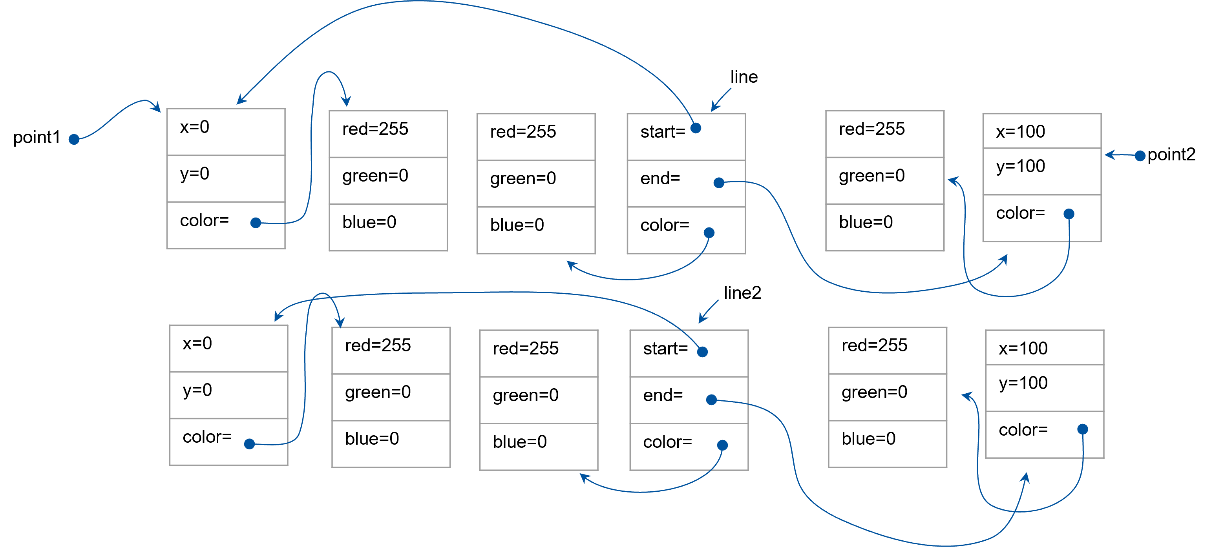
Understanding memory layouts
Classes allow us to combine data and methods into a grouping or class and use that grouping as a data type in our programs.
Notice point1 and point2 are still the same references as we have in line. We can clone the points making them distinct.

Slide 32
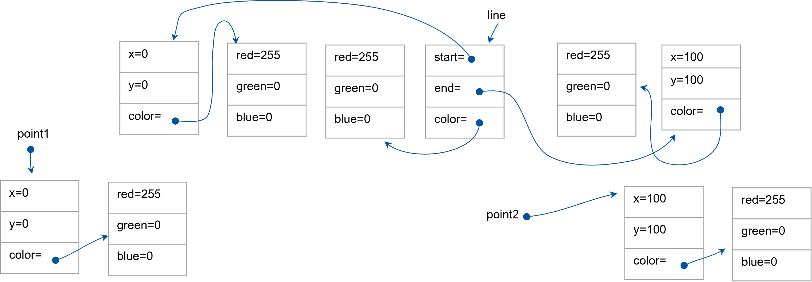
Understanding memory layouts
Classes allow us to combine data and methods into a grouping or class and use that grouping as a data type in our programs.
let point1: Point = new Point(0, 0, new Color(255,0,0)); let point2: Point = new Point(100, 100, new Color(255,0,0)); let line: Line = new Line(point1.clone(), point2.clone(), new Color(255,0,0));

Slide 33
Understanding memory layouts
Classes allow us to combine data and methods into a grouping or class and use that grouping as a data type in our programs.
By using our clone methods in all of our classes, this code now has each element of each class as a distinct instance.

Slide 34
Summary
Classes allow us to combine data and methods into a grouping or class and use that grouping as a data type in our programs.
The simplest way to ensure deep cloning is to teach each class how to deep copy itself. If we do this then classes that contain the class in question can just call its clone method to deep copy it.

Slide 35
Chapter Summary
In addition to storing data (Data Classes), classes can also contain methods. These methods can operate on the data within the class without regard to its visibility. We can change the visibility of a member property or method with the public/private keywords. Anything marked as public is accessible outside of the class instance. Anything marked as private can only be accessed within a method inside that class.

