Slide 1
CISC 181-INTRODUCTION TO COMPUTER SCIENCE II
Week 13
Spring 2024

Slide 2
Introduction

Slide 3
Complex Types
Data Classes allow us to combine data into a grouping or class and use that grouping as a data type in our programs.
If we wish to combine data into a more complex type that represents the combination of various related data items, then there are two methods available to us in TypescriptThe interfaceWe will discuss interfaces and how and when to use them, later in the text. For the time being we will focus on classes, and specifically Data Classes.
Interfaces describe the data that goes into an object and its types, but do not provide default values, or any additional logic.
The class
Classes also describe the data that goes into an object, but provide a mechanism to set default values, construct the objects dynamically, and even define methods to operate on the internal data.

Slide 4
Classes in Typescript
Data Classes allow us to combine data into a grouping or class and use that grouping as a data type in our programs.
To declare a class in typescript, we use the class keyword. The structure of a class internally is a set of data objects that make up the class.
class MyType{ //list of variables and types //constructor method to create an instance //0 or more methods which can operate on //the member variables in the class }

Slide 5
Classes in Typescript
Data Classes allow us to combine data into a grouping or class and use that grouping as a data type in our programs.
Remember a class is a definition of a type. You must create an instance of that type in order to use it. We can define a variable of our new type and use it.
let myObj:MyType=new MyType();

Slide 6
Motivation
Data Classes allow us to combine data into a grouping or class and use that grouping as a data type in our programs.
Some things things belong together as they describe a more complex thing that we want to represent.
As an example, consider a simple drawing program we might want to build.
Points have an x and y coordinate which are numbers
Lines contain a start and end point
Rectangles can be defined by 2 points (opposite corners)
Polygons can be defined by an arbitrary list of points (The vertices)
Each of these objects may have a color associated with it. (Color itself might contain components for Red, Green, and Blue as numbers.

Slide 7
Summary
Data Classes allow us to combine data into a grouping or class and use that grouping as a data type in our programs.
Sometimes it makes sense to group data together. In these cases Typescript provides multiple mechanisms with which to do that. In the section we have introduced the idea of creating a class that represents a set of heterogeneous data. (i.e. strings, numbers, booleans, arrays, and other classes).

Slide 8
Basic Data Classes

Slide 9
Color class
Data Classes allow us to combine data into a grouping and use that grouping as a data type in our programs.
If we examine the objects we have proposed for our drawing program (points, lines, rectangles, polygons, color) we can see that just about everything has a color. The definition for a type that represents color would be useful as then we could group the things that make up a color. For our example we want to store a color as three numbers between 0 and 255 representing the red, green, and blue intensities.
Our class should contain 3 numbers (Red, Green, and Blue). We can define our class as described previously, since this contains only the primitive type number.
class Color{ public red:number=0; public green:number=0; public blue:number=0; }

Slide 10
Color class
Data Classes allow us to combine data into a grouping and use that grouping as a data type in our programs.
Note the public keyword before each member variable (sometimes called a property) of the class. This denotes that the property is accessible by methods and code outside the class. We could also mark it as private or protected.
As you can see, our class definition is quite simple. We simply group the three components together and give it a name. We can then create objects of this type with the new keyword.
let myColor:Color=new Color();

Slide 11
Color class
Data Classes allow us to combine data into a grouping and use that grouping as a data type in our programs.
Note: If red, green, and blue had been labeled private, then we could not have accessed them. More on this later in the text.
And for a full example:
class Color{ public red:number=0; public green:number=0; public blue:number=0; } //We can use our new class to create a color object: let myColor:Color=new Color(); //Then we can access its public members myColor.red=255; myColor.blue=128; myColor.green=10; console.log(myColor);

Slide 12
Point class
Data Classes allow us to combine data into a grouping and use that grouping as a data type in our programs.
A point requires coordinates, x and y. These are both numbers. It also requires a color if we want points to be displayable (more on this later). We already have a definition for a color, so we can use that to define a point.
class Color{ public red:number=0; public green:number=0; public blue:number=0; } class Point{ public x:number=0; public y:number=0; public color:Color=new Color(); } let myPoint:Point=new Point(); myPoint.x=100; myPoint.y=100; myPoint.color.red=255;_x000B_myPoint.color.blue=128; myPoint.color.green=10; console.log(myPoint);

Slide 13
Point class
Data Classes allow us to combine data into a grouping and use that grouping as a data type in our programs.
Notice that we use the class Color inside of the class Point. This is referred to as composition and is a critical concept in understanding classes and Object Oriented Programming.
We can build up complex objects by including other objects inside of them. Now every point will have a position (x,y) and a color contained inside the point itself.

Slide 14
Summary
Data Classes allow us to combine data into a grouping and use that grouping as a data type in our programs.
Complex objects can be built from simpler ones by creating a class to represent a new type.

Slide 15
Data Class Constructors

Slide 16
Class constructors
Data Classes allow us to combine data into a grouping or class and use that grouping as a data type in our programs.
So far, to create a class we:
Create an instance of a class with the new keyword and store it in a variable
Use the variable to modify the properties of the class individually
For our Color example, this means setting red, green, and blue independently.

Slide 17
Class constructors
Data Classes allow us to combine data into a grouping or class and use that grouping as a data type in our programs.
It would be much easier to have a function that takes the parameters we want to set and updates the object as it is being created.
class Color{ public red:number=0; public green:number=0; public blue:number=0; constructor(red:number,g:number,b:number){ this.red=red; this.green=g; this.blue=b; } }

Slide 18
Class constructors
Data Classes allow us to combine data into a grouping or class and use that grouping as a data type in our programs.
By giving our class a constructor, we can create an instance of the class and initialize its values in one line:
let veryRed:Color=new Color(255,0,0); let veryBlue:Color=new Color(0,0,255); let anotherColor:Color=new Color(27,115,98); console.log(veryRed,veryBlue,anotherColor);

Slide 19
Class constructors
Data Classes allow us to combine data into a grouping or class and use that grouping as a data type in our programs.
Note that now we are creating and initializing our objects in one line.
While much better, the definition of Color still seems repetative. While 100% correct, Typescript gives us a shorthand.
class Color{ constructor(public red:number, public green:number, public blue:number){ //Note we don’t need anything inside. This automatically does everything. } } //this behaves equivalently in every way to our previous example. let veryRed:Color= new Color(255,0,0); console.log(veryRed);

Slide 20
Class constructors
Data Classes allow us to combine data into a grouping or class and use that grouping as a data type in our programs.
If we declare the parameters of the constructor with the private or public keywords, it both declares them as members, and initializes their values from the values passed into the constructor.
Note that without the public or private keywords, the parameter is just local to the constructor function, but when included, the parameter becomes a member variable (property) and gets initialized to the value passed in.
Back to the drawing program, we can now rebuild our classes using constructors and the Typescript shorthand.
class Color{ constructor(public red:number, public green:number,public blue:number){ } } class Point{ constructor(public x:number,public y:number,public color:Color){} } // We can build a point in a few ways. let myPoint:Point=new Point(100,100,new Color(0,0,255)); //create color on the fly let red:Color=new Color(255,0,0); let myOtherPoint:Point=new Point(200,200,red); //use an existing color object console.log(myPoint); console.log(myOtherPoint);

Slide 21
Other Drawing classes
Data Classes allow us to combine data into a grouping or class and use that grouping as a data type in our programs.
What other classes do we need:
The Line class simply needs two points (start and end) and a color. We define the class to have those three components and initialize them with a constructor
class Color{ constructor(public red:number, public green:number,public blue:number){ } } class Point{ constructor(public x:number,public y:number,public color:Color){} } class Line{ constructor(public start:Point,public end:Point,public color:Color){} } class Rectangle{ constructor(public corner1:Point,public corner2:Point,public color:Color){} }

Slide 22
Polygons
Data Classes allow us to combine data into a grouping or class and use that grouping as a data type in our programs.
Now we can represent basic shapes in a coordinate system and each shape has a color, but what about polygons. First, let's list what we know about them:
Generalized polygons have 3 or more points which are connected.
Polygons have a color

Slide 23
Polygons
Data Classes allow us to combine data into a grouping or class and use that grouping as a data type in our programs.
Since we don't know how many points there are to start with, we can represent the list of points using an array.
class Polygon{ constructor(public points:Point[],public color:Color){} }
The polygon class is initialized by and contains a public member whose type is an array of Point classes. It also has an instance of a Color class.

Slide 24
Trying it out
Data Classes allow us to combine data into a grouping or class and use that grouping as a data type in our programs.
class Color{ constructor(public red:number, public green:number,public blue:number){ } } class Point{ constructor(public x:number,public y:number,public color:Color){} } class Line{ constructor(public start:Point,public end:Point,public color:Color){} } class Rectangle{ constructor(public corner1:Point,public corner2:Point,public color:Color){} } class Polygon{ constructor(public points:Point[],public color:Color){} } let red:Color=new Color(255,0,0); let blue:Color=new Color(0,0,255); let points1:Point[]=[new Point(0,0,red),new Point(100,0,red),new Point(50,100,red)]; let points2:Point[]=[new Point(50,100,blue),new Point(100,100,blue),new Point(0,100,blue)]; let redTriangle:Polygon=new Polygon(points1,red); let blueTriangle:Polygon=new Polygon(points2,blue); let drawing:Polygon[]=[redTriangle,blueTriangle]; console.log(drawing);
With this code, drawing represents a drawing with two triangles (red and blue). If we wrote a program to render these objects, we would have all of the information that is needed.

Slide 25
Trying it out
Data Classes allow us to combine data into a grouping or class and use that grouping as a data type in our programs.

Slide 26
Summary
Data Classes allow us to combine data into a grouping or class and use that grouping as a data type in our programs.
To simplify the creation and initialization of a data class, we can provide a constructor method that takes parameters and can be used to set initial values for the member properties. If the parameters are preceeded by the words public or private, they automatically become member variables and get initialized to the values passed to the constructor. The constructor is called by using the new keyword to create an new instance of the class.

Slide 27
Instances and References

Slide 28
Understanding Instances and References
Data Classes allow us to combine data into a grouping or class and use that grouping as a data type in our programs.
When we define a class using the class keyword, we are creating a type. This type does not exist in memory, but is a template for creating objects that have the methods and fields described in the class. When we use the new keyword, we create an instance of the class in memory and return a reference to the in memory object. If we call new again, we get a second instance of the class and a second reference to the new memory location.
import {Color,Point,Polygon} from 'ch2/drawing1'; let red:Color=new Color(255,0,0); let points1:Point[]=[ new Point(0,0,red), new Point(100,0,red), new Point(50,100,red) ]; let redTriangle:Polygon= new Polygon(points1,red); console.log(redTriangle);

Slide 29
Understanding Instances and References
Data Classes allow us to combine data into a grouping or class and use that grouping as a data type in our programs.
Examining this code in more detail, we see that each time new is called, we are creating an instance of the class. That means that each time we call new, we are allocating a new chunk of memory to hold the values of that instance. What is returned, is not the value of the class, but a reference to the created object.
Consider the following code:
let red:Color=new Color(255,0,0); let point:Point=new Point(0,0,red); let point2:Point=point;

Slide 30
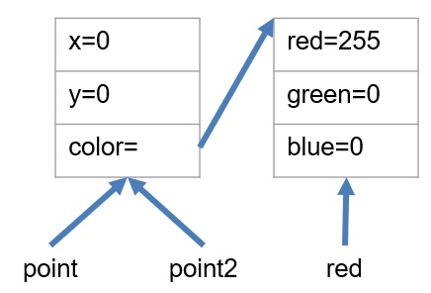
Understanding Instances and References
Data Classes allow us to combine data into a grouping or class and use that grouping as a data type in our programs.
Graphically, this looks like:

Slide 31
Understanding Instances and References
Data Classes allow us to combine data into a grouping or class and use that grouping as a data type in our programs.
What would happen if we update point.x. In this case we would also update the instance pointed to by point2, because they are the same instance. When we set point2=point; we are setting the variable point2 to contain the reference stored in point, and thus they reference the same chunk of memory allocated by the one and only call to ```new Point(...).
Let's see that in action.
import {Color,Point} from 'ch2/drawing1'; let red:Color=new Color(255,0,0); let point:Point=new Point(0,0,red); let point2:Point=point; point.x=100; console.log(point2);

Slide 32
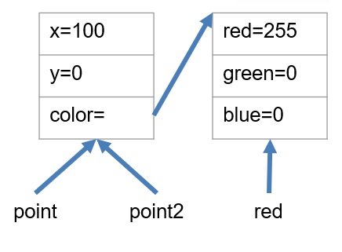
Understanding Instances and References
Data Classes allow us to combine data into a grouping or class and use that grouping as a data type in our programs.
As you can see, updating point updates the memory location referenced by point which is the same memory location referenced by point2. In other words, we only have _x000B_one point, but we have two references or aliases to that point. Changing either one, changes the one and only object that the variables point and point2 refer to.
Note: Sometimes this is what we want, but sometimes IT IS NOT!!!
Later, we will look at other methods to create new objects based on existing objects, but for now, we would have to call new again and set point2 to that new object, then update its properties with the properties of point.

Slide 33
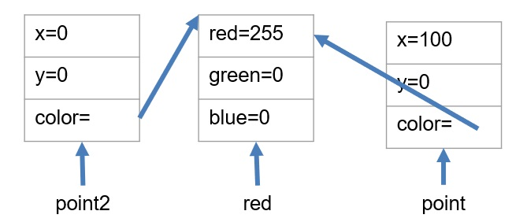
Understanding Instances and References
Data Classes allow us to combine data into a grouping or class and use that grouping as a data type in our programs.
import {Color,Point} from 'ch2/drawing1'; let red:Color=new Color(255,0,0); let point:Point=new Point(0,0,red); let point2:Point=new Point(point.x,point.y,point.color); point.x=100; console.log(point); console.log(point2);

Slide 34
Understanding Instances and References
Data Classes allow us to combine data into a grouping or class and use that grouping as a data type in our programs.
This is a shallow copy of an object as we are only copying the top level. This will make a new object, but only copy the top level or primitive types (number, boolean, string). Any deeper objects or arrays still remain as references.
What if we want a deep copy. In other words, each point will, in addition to having a unique memory location for its primitive values, will also have a reference to a different Color object.
import {Color,Point} from 'ch2/drawing1'; let red:Color=new Color(255,0,0); let red2:Color=new Color(255,0,0); let point:Point=new Point(0,0,red); let point2:Point=new Point(point.x,point.y,red2); point.x=100; console.log(point); console.log(point2);

Slide 35
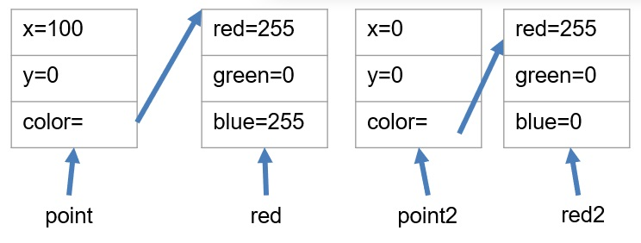
Understanding Instances and References
Data Classes allow us to combine data into a grouping or class and use that grouping as a data type in our programs.
This is probably what we wanted. This is called a deep copy. While there are some ways to do this automatically in Typescript, they do not work in all cases, and can be problematic. We can do this manually as in this example, but we will look at better ways later.

Slide 36
Summary
Data Classes allow us to combine data into a grouping or class and use that grouping as a data type in our programs.
Understanding references and instances is critical in nearly all programming languages. In typescript, every variable whose type is not a primitive type (string, boolean, number) stores a reference to the object. From our examples:
point2=point; //makes a copy of the reference to the one and only object
A shallow copy of the object only copies the top level primitive types, but does not duplicate any contained objects, rather it copies the reference to the same object.
A deep copy of the object makes copies of all of the objects, nested objects and primitive types. Gives you a true clone of the object that is independent of the original. Later, we will learn how to clone the object, but for now, we have to create an independent object with the same values.

Slide 37
This keyword

Slide 38
Overview
Data Classes allow us to combine data into a grouping or class and use that grouping as a data type in our programs.
There is a special keyword this that can be used from inside the constructor (or any method inside the class) that will allow us access to the member variables of the object.

Slide 39
Abstracting the constructor
Data Classes allow us to combine data into a grouping or class and use that grouping as a data type in our programs.
Consider our color class
class Color{ constructor(public red:number, public green:number,public blue:number){ } }

Slide 40
Abstracting the constructor
Data Classes allow us to combine data into a grouping or class and use that grouping as a data type in our programs.
What if instead of passing in values for red, green, and blue, we wanted to pass in a string (either “red”,”green”, or “blue”) to initialize our color to one of these three colors. We can go back to our original syntax and define the members explicitly, and change our constructor to take a string that is not marked with the public or private keywords since we only need it to initialize the members.
class Color{ public red:number=0; public green:number=0; public blue:number=0; constructor(colorStr:string){ //what goes here } }

Slide 41
Abstracting the constructor
Data Classes allow us to combine data into a grouping or class and use that grouping as a data type in our programs.
The idea is that we can use the string to determine how to set the members. We can use the this keyword to access the member variables of the current instance.
class Color{ public red:number=0; public green:number=0; public blue:number=0; constructor(colorStr:string){ if (colorStr==="red"){ this.red=255; } else if (colorStr==="green"){ this.green=255; } else if (colorStr==="blue"){ this.blue=255; } } } console.log(new Color("red")); console.log(new Color("green")); console.log(new Color("blue"));

Slide 42
Abstracting the constructor
Data Classes allow us to combine data into a grouping or class and use that grouping as a data type in our programs.
Here we can initialize our members indirectly by using the value of the parameter colorStr. The this keyword allows us access to our own members from within the instance. If the string is not recognized (i.e. not red, green, or blue) then the default values of (0,0,0) remain which is our intention. We would want to make a comment on our constructor that this is the behavior to help users of our class to know how to use it.

Slide 43
Summary
Data Classes allow us to combine data into a grouping or class and use that grouping as a data type in our programs.
Typescript allows the use of the this keyword in order to access the members of the current instance of the class. From within the class, using the this keyword allows us access to all of the member properties (public or private) within the class instance.

Slide 44
Chapter Summary
Data Classes allow us to combine data into a grouping or class and use that grouping as a data type in our programs.
Now we have the ability to create complex data types of our own using the class keyword. These data types can contain any other type of object including another class, a primitive type, or an array. There is no limitation on what the array or embedded class contain (other class objects, arrays of primitives, arrays of other class objects, etc.) We have a special method in our objects called a constructor. The constructor can be used to initialize our object, or by using the public and private keywords, it can define members of our object. Parameters without these keywords behave just like parameters to any other function, but with these keywords, that parameter also becomes a member of the object. We can access the members of our class instance using the this keyword.

