Slide 1
CISC 181-INTRODUCTION TO COMPUTER SCIENCE II
Week 13
Spring 2024

Slide 2
Dynamic Components

Slide 3
Building dynamic applications
We can create and attach components dynamically in order to create complex applicaitons.
Say we wanted to make a simple point of sale system.
Getting the customer name and order number is easy. We just create some input boxes and bind the @Input event to a function that updates an internal variable.
We can easily bind the @Click event of buttons to add new items to our order.
How do we deal with a variable number of line items in the order?

Slide 4
Building dynamic applications
We can create and attach components dynamically in order to create complex applicaitons.
Let's start by creating a simple page in html/css for the things we know how to do, and a div to hold our line items once we create them.
<div class="form-container"> Customer Name: <input type="text" id="customerName" /><br /> Order Number: <input type="text" id="orderNumber" /> <div class="detail-header"> Order Details: <button id="addItemButton">New Item</button> <button id="addCommentButton">New Comment</button> <div id="counter">0</div> </div> <div id="orderDetails"></div> </div>

Slide 5
Building dynamic applications
We can create and attach components dynamically in order to create complex applicaitons.
.detail-header { font-size: 20px; color: white; margin-bottom: 20px; background-color: black; padding: 10px; } #counter { display: inline-block; }
Now in the typescript file, we need to create variables to hold our order number and customer name. These will be updated, but not bound directly (they could be). We also need functions that are bound to the @Input event of these text boxes. Finally we need functions bound to our add buttons.

Slide 6
Building dynamic applications
We can create and attach components dynamically in order to create complex applicaitons.
orderNumber: string = ""; customerName: string = ""; @BindValueToNumber("counter", " items in cart") count: number = 0; @Input("orderNumber") onOrderNumberChange(e: ValueEvent) { this.orderNumber = e.value; } @Input("customerName") onCustomerNameChange(e: ValueEvent) { this.customerName = e.value; } @Click("addItemButton") onNewItemClick() { //Add the item here } @Click("addCommentButton") onNewCommentClick() { //Add the comment here }
Note we have not implemented onNewItemClick or onNewCommentClick, but we have the methods hooked up to the buttons so we just have to write the contents.
So what do we do inside the click handlers? Assume we have created components for one line item or one line comment already using the cli. Then we:

Slide 7
Building dynamic applications
We can create and attach components dynamically in order to create complex applicaitons.
Create the correct type of child component (info or comment) and store it somewhere so we can reference it later.
Add it to our orderDetails div so they show up in order created where we want them.
Increment the counter if it’s an item
Note: Since count is already bound to the counter div, all we have to do is update the variable to update the counter on the screen.

Slide 8
Building dynamic applications
We can create and attach components dynamically in order to create complex applicaitons.
items: LineItemComponent[] = []; comments: LineCommentComponent[] = []; @Click("addItemButton") onNewItemClick() { const item = new LineItemComponent(); this.items.push(item); this.addComponent(item, "orderDetails"); this.count++; } @Click("addCommentButton") onNewCommentClick() { const comment = new LineCommentComponent(); this.comments.push(comment); this.addComponent(comment, "orderDetails"); }

Slide 9
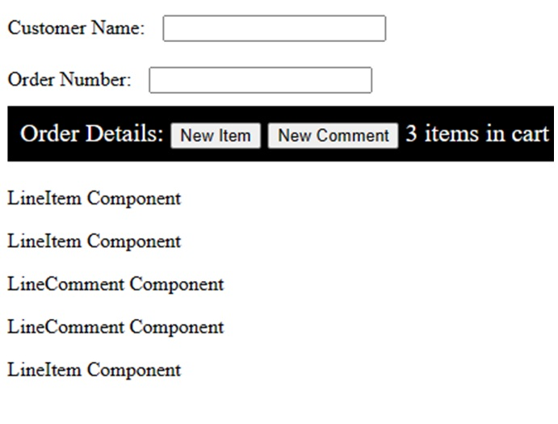
Building dynamic applications
We can create and attach components dynamically in order to create complex applicaitons.
This is what our website looks like when we run it. If we type in the text boxes, our member variables are automatically updated. If the count property of the class is changed, the number of items in the cart will change. If we click on our buttons, our event handlers are called. Those click handlers create a new component and add it to the orderDetails in the order they are created.

Slide 10
Building dynamic applications
We can create and attach components dynamically in order to create complex applicaitons.
This is what our website looks like after we press new item twice, comment twice, then new item a third time. Since the click handler updated count, the correct count is displayed. The different types of line items are interspersed. They are displayed in the page where we want them since we added them to the orderDetails element.

Slide 11
Summary
We can create and attach components dynamically in order to create complex applicaitons.
We can create dynamic components by adding them to an existing component using the addComponent(...) method. Adding components dynamically allows us to create interactive web applications and reuse components (like our line item component) over and over again as appropriate.

Slide 12
Webz Events

Slide 13
Component heirarchy.
We can pass events between components so that our components can communicate.
We can view the component hierarchy as a tree where MainComponent is the root. Each time MainComponent creates a new component, it is a child of MainComponent. Those children can themselves create and attach new components. What we are left with is a heirarchy of components related to each other as parent and child

Slide 14
Talking to our children
We can pass events between components so that our components can communicate.
Talking to our children is easy. We created them, so we probably have (or at least we should have) a reference to them. Through this reference we can modify public properties and call public methods on the child. In this way we can communicate important information (that something has changed or some action is required) to the child. For deeper heirarchies, we can have each parent notify its child down the heirarchy until the child we wish to notify is reached.

Slide 15
Talking to our parents
We can pass events between components so that our components can communicate.
Unlike communicating with children, a child likely does not have a reference to the parent object. This means we need a mechanism for a child to send inforamtion to its parent that some event has occurred.

Slide 16
The Webz Notifier
We can pass events between components so that our components can communicate.
We can create a public Notifier member on the child class and subscribe to that event in the parent class. That event can then be triggered in the child to notify the parent that something has changed. The contents of the Notifier can be anything we want from a value to a class to an array of either.
We will talk about generics in detail later, but we need a basic understanding in order to use Notifier. Notifier is a Generic Class in that we can change the internal type of the class by specifying what type of event object the Notifier emits. First, let’s look at the Notifier class that we will be using:
It has a method notify(data) that fires the event (usually called in the child component)
It has a method subscribe((data)=>void) that attaches a function to the event when it is called.

Slide 17
The Webz Notifier
We can pass events between components so that our components can communicate.
What type of object is data? Because Notifier is Generic we get to choose.
When we create a variable of type Notifier we can supply a type parameter to tell us what type of object Notifier emits.
event:Notifier = new Notifier(); event2:Notifier<number> = new Notifier<number>(); event3:Notifier<string> = new Notifier<string>(); event4:Notifier<SomeClass> = new Notifier<SomeClass>(); event5:Notifier<string[]> = new Notifier<string[]>();

Slide 18
The Webz Notifier
We can pass events between components so that our components can communicate.
The first line creates an Notifier that does not emit data, just a notification.
The second line creates an Notifier that emits a number.
The third line creates an Notifier that emits a string.
The fourth line creates an Notifier that emits an instance of a custom class
The fifth line creates an Notifier that emits an array of strings.
The <> syntax is used to specify one or more type parameters that alter the class internally to support that type.
Now we can pass that type of data to the notify method.

Slide 19
The Webz Notifier
We can pass events between components so that our components can communicate.
this.event.notify(); this.event2.notify(1); this.event3.notify("hello"); this.event4.notify(new SomeClass()); this.event5.notify(["hello","eventsubject","world"]);
The type parameter specifies the type expected for the next method. Using the wrong type will be an error.
Let's look at the two methods we will be using (there are others, but we don't need them yet).
notify(data:T):void
We call notify to ask the Notifier to emit our data (call any subscribed methods). We pass it the data we want to emit which must be of the type specified in the type parameter we used to create the property. Calling this repeatedly will repeatedly call the subscribed methods. In other words, the subscriptions last until they are unsubscribed.
subscribe((data:T)=>void,?(err:Error)=>void)
When the child calls notify(...), the method passed in the first parameter is called. When the error(...) method of the Notifier is called, the function in the second parameter is called. The second parameter is optional.
In the parent, we can call subscribe to attach an anonymous function that will run each time the child calls notify(...) and optionally, another to hand when the child calls error(...).

Slide 20
The Webz Notifier
We can pass events between components so that our components can communicate.
this.event2.subscribe( (value: number) => { console.log(value + 1); }, (err: Error) => { console.error(err); }, );
event2.next(4) called in the child would print 5 from the parent.
Event2.error(new Error(“Bad stuff”)) would print the error object as an error from the parent.

Slide 21
The Webz Notifier
We can pass events between components so that our components can communicate.
Note: This second parameter is optional if you don’t want error notifications.
Let’s apply this to our LineCommentComponent from the previous seciton. First we need to define it:
<div class="line-comment"> Comment: <input id="comment" type="text" /> </div>

Slide 22
The Webz Notifier
We can pass events between components so that our components can communicate.
.line-comment { border-bottom: 1px solid black; padding: 10px; }
export class LineCommentComponent extends WebzCmponent { constructor() { super(html, css); } @Input("comment") onItemInputChange(e: ValueEvent) { //emit the value to parent } }

Slide 23
The Webz Notifier
We can pass events between components so that our components can communicate.
Keeping it simple, we are just getting the input event from the text input box and calling a method (onItemInputChange). Now we can add our Notifier to the class and use it to notify when the text changes:
export class LineCommentComponent extends WebzComponent { commentChange: Notifier = new Notifier(); constructor() { super(html, css); } @Input("comment") onItemInputChange(e: ValueEvent) { this.commentChange.notify(e.value); } }

Slide 24
The Webz Notifier
We can pass events between components so that our components can communicate.
* The public property commentChange is of type Notify and emits a string. * The method now calls next with the new value. And that’s it, our child class now emits to its subscriptions whenever the user types and this will happen for each line comment we create. We would do something similar for each of the fields in a line item. Now we have to subscribe to the event in the parent. We can do this when we create the child so that we will be notified about changes to each comment.
@Click("addCommentButton") onNewCommentClick() { const comment = new LineCommentComponent(); this.comments.push(comment); this.addComponent(comment, "orderDetails"); comment.commentChange.subscribe((comment:string) => { console.log(comment); }); //Add the comment here }

Slide 25
The Webz Notifier
We can pass events between components so that our components can communicate.
Since we never threw an error, we did not bother with a method to handle the error. Now each time the user types in any of the input boxes for comments, the value will be logged by the parent. Of course so far, we are just looging the comment. Let's create an array and counter to store the comments and update them when they change.
private commentText:string[]=[]; private commentCount:number=0;
@Click("addCommentButton") onNewCommentClick() { const comment = new LineCommentComponent(); this.comments.push(comment); this.commentText.push(""); this.addComponent(comment, "orderDetails"); let index = this.commentCount++; comment.commentChange.subscribe((comment: string) => { this.commentText[index] = comment; console.log(this.commentText); }); }

Slide 26
The Webz Notifier
We can pass events between components so that our components can communicate.
Now we can push a new empty string onto our new array when we create the comment and update it in our subscribe callback. Now at any point, commentText in the parent contains the current value of all the comment children. We could do something similar for our line items and store them in an array itemList. If we added a save button in the parent, we would have the commentText and itemList which we could save in any way we want. As we type in the child component, it catches the Input event and emits the current value through the Notifier of each line item. Each time the Notifier emits a value, we update the appropriate element in our value array. Now we don’t even need to think about what is going on in the child in order to get the values from them. We could do this by querying each child component for its value when we need it, but this is a much nicer solution and gives us real time updates in the parent class. ## Summary Passing information between components is critical to developing web applications. Passing information is simple from parent to child because the parent created the child and thus has a reference to it. Passing information from child to parent can be accomplished in Webz using the ***notifier*** class. A child calls the ```notify(...)``` method, and the parent can subscribe to that Notifier. # Next Step Next we'll learn about dialogs and popups [Webz Dialogs &raquo;](../10-webz-advanced/dialogs.md) # !BEGIN NEW SECTION (Webz Dialogs)! ## Key Idea Popup windows and dialog boxes can be challenging in web development. Webz provides an easy mechanism for creating them. ## Overview Sometimes we want to create an overlay window that sits on top of our page, prevents us from clicking elsewhere on our page, and has its own content and behaviors. Webz provides two methods for doing this: * Popup: Creates a popup window with a title, some text, and buttons that returns the text on the button through a Notifier. * Dialog: Creates a popup window whose content is determined by a component. These can be created with the cli (webz dialog my-dialog). ## Popups The popup window is provided as an easy way to interact with your user for a quick message or question. This is similar to the javascript alert/confirm methods, but looks a lot better and is more flexible. To show a popup we simply call the popup method of the WebzDialog class. This is a static method (means it does not exist on an instance of WebzDialog but rather can be called directly on the type).
EzDialog.popup(attachTo: EzComponent, message: string, title?: string, buttons?: string[], btnClass?: string):Notifier

Slide 27
The Webz Notifier
We can pass events between components so that our components can communicate.
We can call this method to show a dialog box:
WebzDialog.popup(this,"Hello World","I am the title",["Yes","No"],"btnClass");

Slide 28
The Webz Notifier
We can pass events between components so that our components can communicate.
Popup returns a Notifier<string> which emits the text of the button pressed. We can subscribe to the returned value to be notified when the popup closed. Let’s examine this in detail: * attachTo (required): is the component that you want to attach the element to. Usually you will pass in this to specify the current component. * Message (required): The text inside the popup * Title (optional): The title for your popup, displayed at the top. * buttons (optional): An array of strings that are the labels of the buttons that you want to display. By default there is a single OK button. * btnClass(optional): An optional css class string to style the buttons. This allows you to optionally attach a css class to the button for styling. * Returns: An event subject that emits the label of the pressed button. Pressing a button, closes the popup. Back to our point of sale example, we can use a popup to notify the user that a comment was added.
@Click("addCommentButton") onNewCommentClick() { const comment = new LineCommentComponent(); this.comments.push(comment); this.commentText.push(""); this.addComponent(comment, "orderDetails"); let index = this.commentCount++; comment.commentChange.subscribe((comment: string) => { this.commentText[index] = comment; console.log(this.commentText); }); WebzDialog.popup(this,"Item added.") }

Slide 29
The Webz Notifier
We can pass events between components so that our components can communicate.
Here we have added a popup with the default title “Alert” and the default buttons [“Ok”]. We have not subscribed since I do not need notification of when the window closes, and there is only one button the user could have clicked. We could have subscribed if I needed to know that the popup was closed. ![](../../assets/images/webz_6.jpg) Notice how the popup greys out the underlying website. You cannot click buttons or enter text while the popup is open. Once it is closed, the gray background goes away and the rest of the page will again accept input. With this screen, the only thing I can do is click ok. Let's look at a more complex example:
@Click("addCommentButton") onNewCommentClick() { WebzDialog.popup(this, "Are you sure?", "Add new item",["Yes","No"], ).subscribe((result: string) => { if (result == "Yes") { const comment = new LineCommentComponent(); this.comments.push(comment); this.commentText.push(""); this.addComponent(comment, "orderDetails"); let index = this.commentCount++; comment.commentChange.subscribe((comment: string) => { this.commentText[index] = comment; console.log(this.commentText); }); } }); }

Slide 30
The Webz Notifier
We can pass events between components so that our components can communicate.
Here we have added a popup to ask the user if they are sure before adding the item, and then only adding it if they click the “Yes” button. We subscribe to the EventSubject returned by the popup method to see when the window closes and which button was pressed. > Note: We moved all of the code inside the anonymous function so that it will only be called after the dialog is closed. ![](../../assets/images/webz_7.jpg) ## Dialogs Dialogs work similarly, except they do not have a pre-defined structure. You can create them as a component where you control the layout and any Notifiers you want to implement. Creating a new dialog is as simple as: ```webz dialog myDialog``` Like webz component, this creates a new component, but it will behave and look like a popup window, only its content will be your new component. The default implementation is a simple popup with an ok button that closes when the user clicks it. We can close a window by calling the member method this.show(true/false). We add it just like any other component using addComponent, then display it by calling show(true).
dialog: MyDialog = new MyDialog(); constructor() { super(html, css); this.addComponent(this.dialog); } showDialog(){ this.dialog.show(true); } hideDialog(){ this.dialog.show(false); }

Slide 31
The Webz Notifier
We can pass events between components so that our components can communicate.
First we create a variable to hold our dialog: We can then add it to the component: > Note, if you want it to display immediately, then you can call show with true ```this.dialog.show(true);``` Whenever we want to show the dialog, we just pass true to it’s show method. To hide it we pass false. If we want to get an event to subscribe to when the window is closed, or something happens in the dialog, we can implement our own Notifiers and subscribe to them in the parent. ### An Example A simple please wait dialog with no buttons. To make this simple, I am just going to use text, but you could use an animated gif or do some css magic to add some movement to this dialog (we will do that in a few minutes with a timer). First we will create a new dialog with the cli: ```webz dialog Pleasewait``` For the body of our dialog, we will just center a string that says “Please Wait…” ```html <div class="content"> <div class="body">Please Wait...</div> </div>
.content { width: 600px; } .body { text-align: center; font-size: 40px; line-height: 100px; }

Slide 32
The Webz Notifier
We can pass events between components so that our components can communicate.
In the parent, we create a property for our dialog and add it to the component.
plsWait: PleaseWaitDialog = new PleaseWaitDialog(); constructor(){ this.addComponent(this.plsWait); }

Slide 33
The Webz Notifier
We can pass events between components so that our components can communicate.
When we want the dialog we can simply display it while some time consuming task is occurring, then hide it after.
this.plsWait.show(true); //do something that takes a while this.plsWait.show(false);

Slide 34
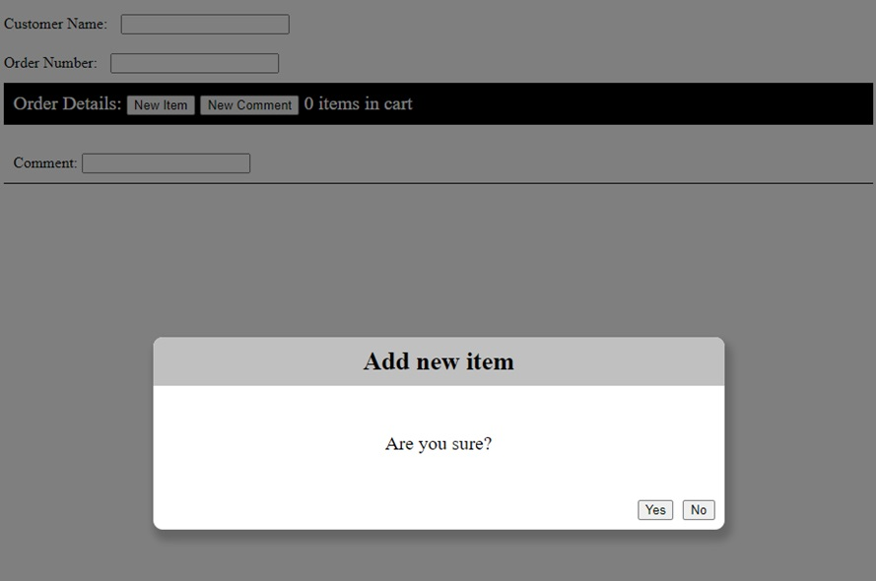
The Webz Notifier
We can pass events between components so that our components can communicate.
Here you can see the output after a call to plsWait.show(true). Just like the popup, the rest of the website is grayed out and cannot be interacted with.

Slide 35
Summary
We can pass events between components so that our components can communicate.
Creating a good user interface is critical to having your software accepted by users. Dialogs and popups are an excellent mechanism for communicating and querying simple information from the user. Webz provides a simple popup method for simple interactions, and a dialog class to derive from for creating custom layouts.

Slide 36
Webz Timers

Slide 37
Overview
We can cause things to happen periodically by using a timer. Timers allow us to schedule actions to occur once per time interval.
Sometimes we want to do something periodically while our site is displayed

Slide 38
Overview
We can cause things to happen periodically by using a timer. Timers allow us to schedule actions to occur once per time interval.
Update a timer
Refresh data from a backend
Move a game element
Animation
Anything else we want to accomplish on an interval.
This can be useful to provide more interactivity to your site.

Slide 39
Using Timers
We can cause things to happen periodically by using a timer. Timers allow us to schedule actions to occur once per time interval.
Returning to our PleaseWait dialog, we can use a timer to make it more interesting. First, we will bind a variable to the text we are displaying:
@BindValue(“displayDots") displayDots: string = "";

Slide 40
Using Timers
We can cause things to happen periodically by using a timer. Timers allow us to schedule actions to occur once per time interval.
We will modify the html and add a div with the id displayDots.
<div class="content"> <div class="body"> Please Wait <div id="displayDots"></div> </div> </div>

Slide 41
Using Timers
We can cause things to happen periodically by using a timer. Timers allow us to schedule actions to occur once per time interval.
And style it so that it has a fixed width and will appear inline after the words Please Wait.
#displayDots { width: 50px; display: inline-block; text-align: left; }

Slide 42
Using Timers
We can cause things to happen periodically by using a timer. Timers allow us to schedule actions to occur once per time interval.
The plan is to change displayDots to contain 1, 2, or 3 dots and change it once a second.
To implement the behavior, we will use the @Timer decorator to decorate a function hat we want called periodically. Passing 1000 to the timer method causes onTimer to be called once a second while the page is displayed (forever: more on this later). 1 second= 1000 milliseconds Each time it is called, we check a counter that will keep track of how many dots are displayed. When we get to 3, we set it back to 0. Otherwise, we draw the correct number of dots (count+1 because count goes from 0-2) by updating our displayDots property which is bound to the page.
@Timer(1000) private onTimer() { if (this.count === 3) this.count = 0; this.displayDots = ".".repeat(this.count + 1); this.count = this.count + 1; }

Slide 43
Summary
We can cause things to happen periodically by using a timer. Timers allow us to schedule actions to occur once per time interval.
We can use a timer to cause a function to be called periodically. The @Timer directive takes the number of milliseconds between calls, and runs until the page exits.

